Slide 1
Module 1
Project management
Part 5

Slide 2
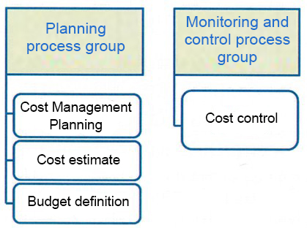
Project Cost Management

Slide 3

Estimate Costs
- Determination of the approximate cost of resources needed to complete the project
Determing Budget
- Summation of estimates of the cost of individual operations or work packages and the formation of a base plan for the cost

Slide 4
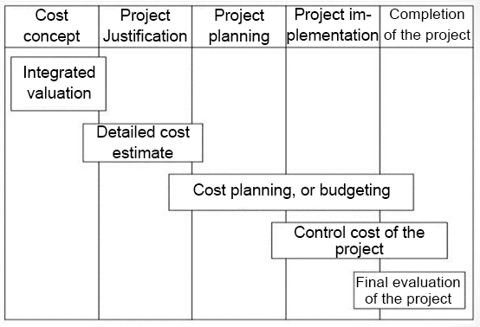

Slide 5
Reserve analysis
Contingency reseves - cash within the base plan for the cost allocated for the identified risks taken, for which possible response measures have been developed to reduce them
Management reserves are the sum of the project budget reserved for management control purposes. It is not part of the basic project plan at cost, but the overall project budget may be included.

Slide 6

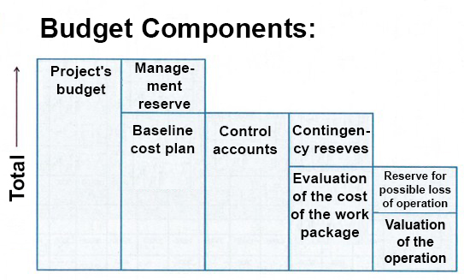

Slide 7
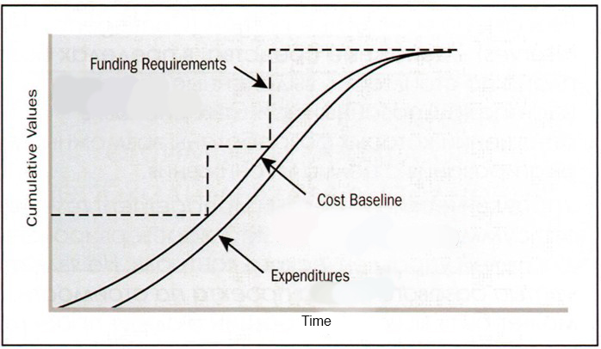
Baseline Costing Plan, Requirements and Funding Requirements

Slide 8
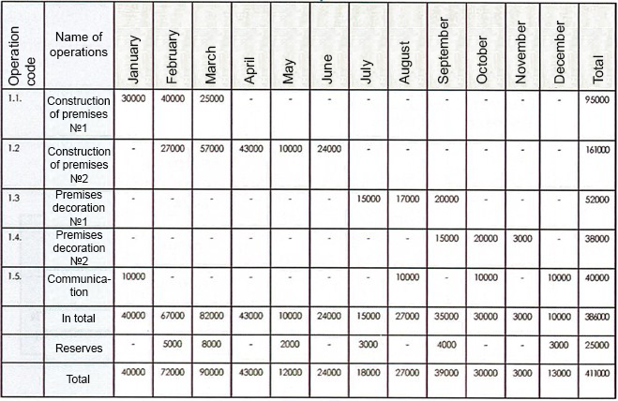
Project Budget (by operations)

Slide 9
Project budget (by articles)
№ | Naming of expenditures | Price, 1000 тg | Justification
1 | Payroll fund
2 | Travel expenses
3 | Supply, installation of equipment and software
4 | Consumables
5 | Services / works of third parties
6 | Rent
7 | Intellectual property protection
8 | Tax liabilities
9 | Banking services
10 | Marketing services
11 | Other
 | Total:

Slide 10
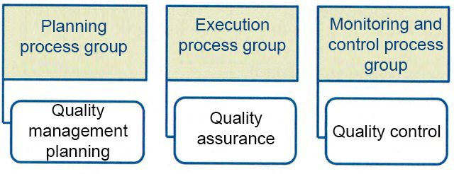

Project Quality Management

Slide 11
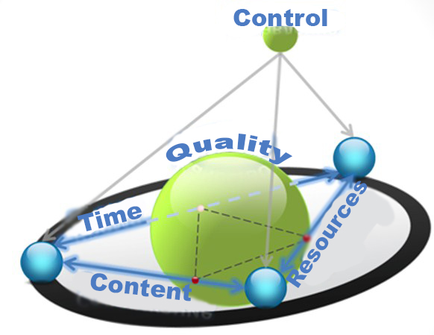

Slide 12

Plan Quality
- Determination of requirements and / or quality standards for the project and product

Slide 13

Cost of quality
Compliance Cost
Cost of prevention (production of a quality product) | Cost of assessment (quality assessment)
Training Documenting processes Equipment Time to do it right | Testing Losses from destructive tests Inspections

Slide 14
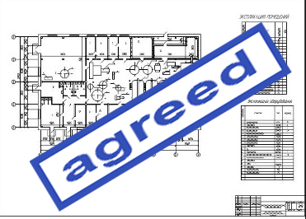

Cost of quality
Cost of nonconformity
Internal costs resulting from defects (defects identified in the project) | External costs resulting from defects (defects identified by the customer)
Improvements Waste | Liabilities Warranty service Loss of profit

